Slide 1
Mineral resources in products and technology

Slide 2
Recap of last class
There are a wide variety of ore minerals
They serve an even wider variety of purposes

Slide 3
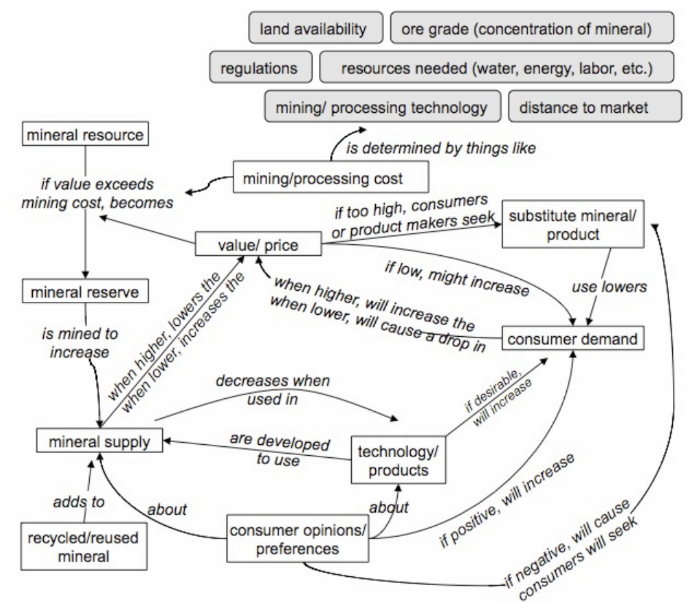
Notes:
Concept map examples:
Tellurium and solar cells –
Tellurium bonds with metals (such as gold, copper, etc.) to make telluride minerals. Tellurium is most often mined by processing the electrolyte sludges from copper mining. Since 2000, tellurium prices have fluctuated dramatically but not as a result of mining; the amount of mining has mostly stayed the same.
In recent years, thin films that use the element tellurium (Te) have become desirable as solar cells. This new technology resulted in an increase in demand for this metal. As a result, the price of Te also increased. These three factors are highlighted in the Unit 2 concept map shown here:
The increased price should prompt an increase in production, but instead demand was met with existing supplies of tellurium. Companies did explore options of opening new mines but did not open any.
Tellurium is also used in metallurgy (to make alloys). Once tellurium's price spiked, metallurgists sought replacement metals. This decreased demand slightly, although demand from solar manufacturers continued to rise. This new set of factors is highlighted in the Unit 2 concept map here:
In 2010, the demand for solar cells dropped (as the consumers who wanted solar panels had purchased them already). Solar energy companies cut production or went out of business. Because the demand by solar energy companies dropped, tellurium's price fell as well.
Cobalt wars in the Congo
The United States is the world's largest consumer of cobalt, but we do not mine any cobalt in this country (we do produce some cobalt by recycling). Cobalt is considered a critical metal and is included in the National Defense Stockpile, "to ensure an adequate supply for military, industrial, and essential civilian needs during a national emergency." (USGS)

Slide 4
Li-ion batteries: primary ingredients are Cobalt and Lithium
Cobalt:
mined from metallic minerals, often found with other metals like copper
used in many other applications (not just batteries), like stainless steel
Most is mined in Africa.

Slide 5
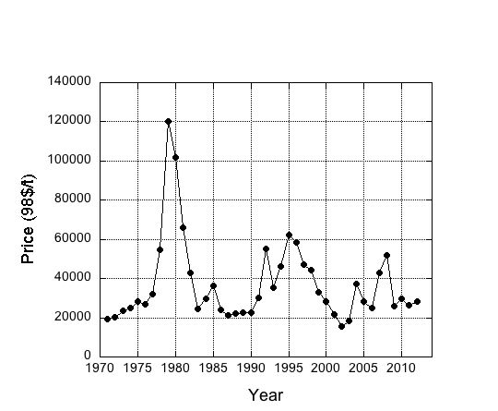
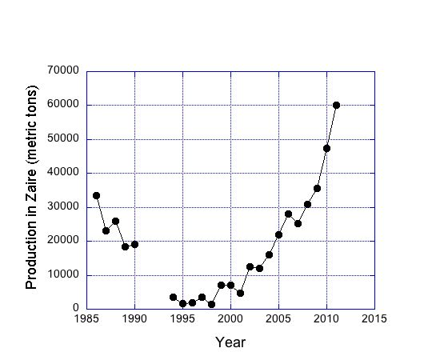
Cobalt
Notes:
Cobalt wars in the Congo
The United States is the world's largest consumer of cobalt, but we do not mine any cobalt in this country (we do produce some cobalt by recycling). Cobalt is considered a critical metal and is included in the National Defense Stockpile, "to ensure an adequate supply for military, industrial, and essential civilian needs during a national emergency." (USGS)
The graph of cobalt price shows a huge spike in the 1970s (in 1998 dollars). The price of cobalt soared primarily because of a supply shortage. In the 1970s, most cobalt was produced in Zaire (now the Democratic Republic of Congo; Congo is again the main world producer of cobalt). Cobalt is produced as a byproduct of copper mining in the region of Shaba. Mining was interrupted in 1977 when separatists invaded Shaba and this supply disruption caused the spike in global cobalt prices (and, sadly, the uprising also killed more than 800 people).
Before the price of cobalt spiked in the late 1970s, samarium-cobalt magnets were used to make sound in speakers and phones, and used in electric motors. But increasing cobalt prices made these magnets less attractive. While researching new (and ideally cheaper) technology, engineers at General Motors and Sumitomo Special Metals invented neodymium magnets, made of neodynium (a rare-earth element), iron, and boron. These are now the main magnet used for electronics and motor technology. The supply-driven price hike led to development of substitute materials (and new technology), as shown by highlighted sections of the concept map.
In the late 1970s, the president of Zaire, Mobuto Sese Seko, nationalized the mining industry. The state-run company Gecamines was a huge cobalt (and copper) producer but had allowed their equipment to age. In the 1980s, the company requested, and was granted, loans from the World Bank, the African Development Bank, and the European Community. But before this money could be spent on updated mining and processing equipment, the loans were withdrawn when the lending agencies found that Gecamines revenue was being used to pay soldiers and build railroads.
Even as the mining infrastructure crumbled, the industry still provided more than 75% of the country's wealth. However, in the 1980s, the international community withdrew support of the Mobuto government. The government could not pay the promised salaries to its soldiers, and they revolted in 1991. Four days of protests and riots centered at the Gecamines mining operations shut the mines. Striking workers burned mining equipment (even destroying newer, state-of-the-art equipment at one mine); more than 30 people died.
In 1992, the World Bank completely pulled out of Zaire. Also, Katangans (members of the main ethnic group) rose up against people from Kasai, an ethnic minority who had, for generations, managed the area's mines. The mines were without equipment and experienced personnel.
The Unit 2 concept map mentions mining cost as a factor, but not closing of mines due to government strife. Figure 2 shows the supply (production) disruption in Zaire. Needless to say, the mine closure resulted in a decrease in global supply and a corresponding increase in cobalt's price that you can see in Figure 1 (although not as severe as the 1970s price jump). The mine closures did more than just affect the global economy; citizens of Zaire were decimated.
In 1994, the mines still employed 2000 of its 3000 employees, but it had been months since these workers received a paycheck. The country's second largest city built near these mines was suffering; no gasoline had been delivered to gas stations in months, and a once-thriving city was in poverty's grasp.
While the mines were closed, people visited the slag piles, digging through the potentially toxic debris to find chunks of metal they could sell.
In the new millennium, the mining industry in Congo has been recovering. Several private companies have purchased the assets of Gecamines and have invested in new mining and processing equipment to pump water out of the abandoned pits and to hire new workers. For example, the Katanga Company has taken over some of the sites.

Slide 7
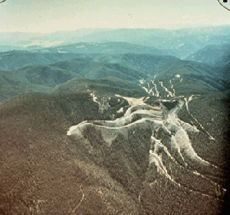
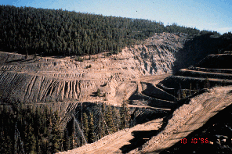
Blackbird Mine
Cobalt mine (using underground and pit mines) in a mountainous, forested area in Idaho.
Streams from this area feed into the Salmon River and were historically spawning grounds for salmon.
Waste rock filled pits, made piles, and was used to cover roads.
Tailings were also piled on site with no concern about water flow (site drainage).
Photos from NOAA (1994 and 1996), from http://www.darrp.noaa.gov/northwest/black/photo.html

Slide 8
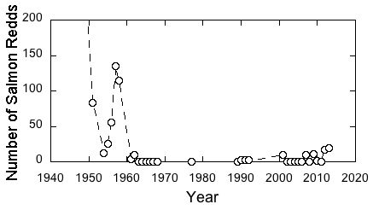
Before 1945, the number of salmon redds in Panther Creek were about 1000. What happened to the amount of salmon breeding (as evidenced by the number of redds) in Panther Creek during the period of mining in Blackbird Mine? (Mining activity in Blackbird Mine peaked in the 1960s; the mine closed in 1982.)
Notes:
Data from:
Mebane, C.A. 1994. Preliminary natural resource survey - Blackbird Mine, Lemhi County, Idaho. U.S. National Oceanic and Atmospheric Administration, Hazardous Materials Assessment and Response Division, Seattle, WA. 130 pp.
Idaho Fish and Game Department. Chinook Redd Counts for Spawning Ground Report. This searchable database can be used to find updated Chinook redd counts in Panther Creek. http://fishandgame.idaho.gov/ifwis/SpawningGroundSurvey/ViewReddSummary.aspx

Slide 9
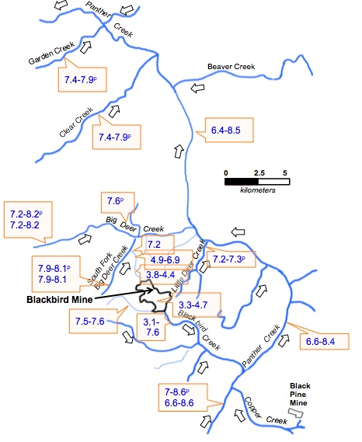
What do you see on this map that suggests that the mining influenced water pH?
Keep in mind that pH is a measure of acidity. Numbers less than 7 are acidic, with smaller numbers being more acidic.
Notes:
Data from and map after:
Mebane, C.A. 1994. Preliminary natural resource survey - Blackbird Mine, Lemhi County, Idaho. U.S. National Oceanic and Atmospheric Administration, Hazardous Materials Assessment and Response Division, Seattle, WA. 130 pp.

Slide 10
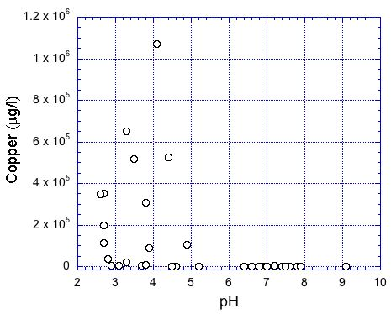
Increased acidity in waters draining mines (where sulfide minerals are present) is called Acid Mine Drainage.
Based on the graph, what is the link between pH and the amount of dissolved metals (as evidenced by copper)?
Notes:
Data from:
Mebane, C.A. 1994. Preliminary natural resource survey - Blackbird Mine, Lemhi County, Idaho. U.S. National Oceanic and Atmospheric Administration, Hazardous Materials Assessment and Response Division, Seattle, WA. 130 pp.

Slide 11
What we learned from Blackbird Mine
Acid Mine Drainage mobilizes metals.
Many metals (in high concentrations) are toxic to organisms. High concentrations of copper is toxic to fish, but also to many insects and microorganisms.
Changes to the Panther Creek ecosystem were directly linked to cobalt mining at Blackbird Mine.

Slide 12
A new cobalt mine (Idaho Cobalt Project) will be opening in the Blackbird Mine area.
Water flowing through waste rock and tailings must not enter area streams.
Places where waste rock and tailings are stored will be lined.
An on-site water treatment plant neutralizes acidic water.
Water quality at spots around the site is continually monitored.
When new mines like this are opened, they must have a reclamation plan.

Slide 13
Li-ion batteries: primary ingredients are Cobalt and Lithium
Lithium:
much of the lithium mined is used in batteries
can be mined from a mineral found in intrusive igneous rock
often mined from brine (very salty water)
most brine-derived lithium is located in one spot of the Andes Mountains of South America

Slide 14
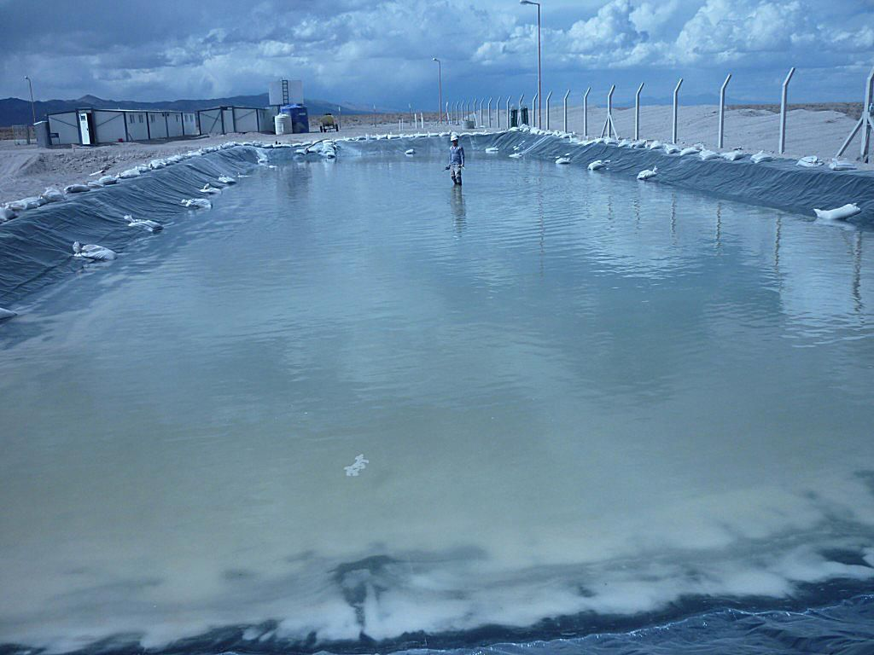
Brine mining is typically more environmentally benign than hard-rock mining
A well is drilled and brine pumped to the surface.
The brine evaporates (in dry climates, no extra energy is needed).
The minerals do need to be separated.
Rocks don’t need to be broken and moved.

Slide 15
Cut-off grade. If the concentration of ore is higher than the cut-off grade, then mining can commence and be profitable. The King's Mountain Belt is an igneous deposit of lithium. Mining operations in North Carolina were suspended in 1991. Therefore, igneous deposits must have different cut-off grades than brine deposits.
 | Country | Concentration of ore (% lithium) | Total amount of resource (Millions tons Li)
Uyanii | Bolivia | 0.0532 | 10.2
Atacama | Chile | 0.14 | 6.3
Kings Mountain Belt | North Carolina, USA | 0.68 | 5.9
Notes:
Data from Gruber, Paul W., Medina, Pablo A., Keoleian, Gregory A., Kesler, Stephen E., Everson, Mark P., and Wallington, Timothy J. (2011) “Global Lithium Availability: A Constraint for Electric Vehicles?” Journal of Industrial Ecology 15, no. 5: 760–75.

Slide 16
Cut-off grade. If the concentration of ore is higher than the cut-off grade, then mining can commence and be profitable.
Why might the mine in North Carolina (igneous) have a higher cut-off grade than the brine mine in Chile?
 | Country | Concentration of ore (% lithium) | Total amount of resource (Millions tons Li)
Uyanii | Bolivia | 0.0532 | 10.2
Atacama | Chile | 0.14 | 6.3
Kings Mountain Belt | North Carolina, USA | 0.68 | 5.9
Notes:
Data from Gruber, Paul W., Medina, Pablo A., Keoleian, Gregory A., Kesler, Stephen E., Everson, Mark P., and Wallington, Timothy J. (2011) “Global Lithium Availability: A Constraint for Electric Vehicles?” Journal of Industrial Ecology 15, no. 5: 760–75.
Possible answers to this question: Mining rock (like in North Carolina) requires blasting apart and moving the rock, as well as separating the element (lithium) from the mineral. Brine mining just pumping salty water from the ground.

Slide 17
Cut-off grade. If the concentration of ore is higher than the cut-off grade, then mining can commence and be profitable.
An igneous deposit in China (Jiajika) is mined, although its Lithium concentration is .59 (Gruber et al., 2011). Why might this mine in China have a different cut-off grade than the U.S. mine?
 | Country | Ore concentration (% lithium) | Total amount (Millions tons Li)
Uyanii | Bolivia | 0.0532 | 10.2
Atacama | Chile | 0.14 | 6.3
Kings Mountain Belt | North Carolina, USA | 0.68 | 5.9
Notes:
Data from Gruber, Paul W., Medina, Pablo A., Keoleian, Gregory A., Kesler, Stephen E., Everson, Mark P., and Wallington, Timothy J. (2011) “Global Lithium Availability: A Constraint for Electric Vehicles?” Journal of Industrial Ecology 15, no. 5: 760–75.
Possible answers to this question: China might have lower mining costs (it might be cheaper because there are less stringent environmental regulations, or the ore is closer to the surface). There might be more ore in the Chinese deposit, which means that start-up mine costs might be worth it because the mine will be operating for longer.

Slide 18
Ore Deposits Research Assignment
Posted on Canvas
Groups posted on Canvas
Discuss expectations

